Slide 1
Sprint 1 Status Update (Final)
Team Name – ClimateGPT Nexus
Monday, September 15, 2025

Slide 2
team Members
Saketh Reddy Puchakayala Scrum Master
Devesh Sidde Developer
Rushikesh Ware Developer
Daniel Berhane Araya Product Owner
Chandra Kiran Reddy Amireddy Developer
Sowdhamini Bharadwaj Mandava Venkata Developer

Slide 3
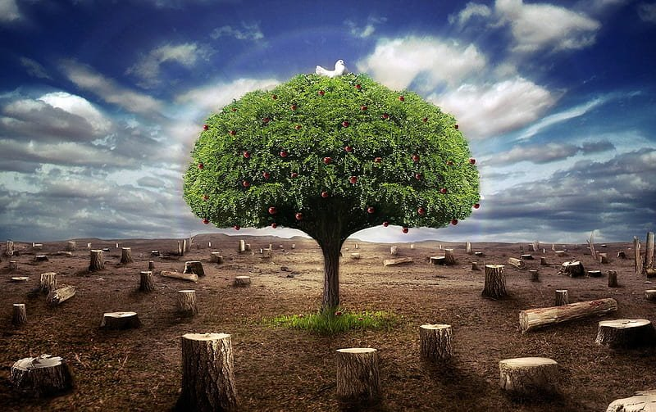
problem statement
Problem Context:
Domain of problem: Climate Analytics
Importance of problem: Climate change threatens communities, economies, and ecosystems worldwide, demanding immediate action. Without reliable and accessible climate data, decision-makers struggle to respond quickly and effectively, making data-driven tools essential for sustainable solutions.
Problem Statement:
Current large language models (LLMs), including ClimateGPT, face critical limitations in supporting climate-related decision-making:
Lack of Data Integration: They rely on static training corpora and cannot directly access structured, curated, and real-time climate data.
Fragmented Information: Climate-relevant datasets(hazard projections, emissions inventories, renewable adoption, socio-environmental metrics) are dispersed and misaligned.
Generalized Outputs: Responses often lack quantitative grounding, are incomplete, and biased toward Global North contexts.
Policy & Research Gap: Without clean, standardized, and region-specific data streams, LLM outputs remain insufficient for evidence-based policy, research, and adaptation planning.
→ The challenge: Bridging advanced language modeling with real-time curated climate data to deliver accurate, equitable, and actionable insights.

Slide 4
Datasets
The Global Forest-carbon dataset tracks tree cover loss, primary forest loss in tropics and carbon emissions/removals across multiple countries.​
Dataset Owner: World Resources Institute (Global Forest Watch)​
Dataset Type: Open source​
Dataset Size: ~7 MB ​
Table 1: Country Tree Cover Loss (2001-2024)​
Comprehensive deforestation tracking (165 countries)​
8 Canopy density thresholds (0%, 10%, 15%, 20%, 25%, 30%, 50%, 75%)​
Enables comparison of deforestation under different forest definitions
Table 2: Country Primary Loss (2002-2024)​
Irreplaceable ecosystem loss: tracks destruction of virgin/old-growth forests ​
75 tropical/subtropical countries where primary forests still exist​
Single threshold (30%)​
Biodiversity proxy - these forests cannot be restored once lost
Table 3: Complete carbon accounting (2001-2024)​
For forest ecosystems across 165 countries ​
Multiple carbon metrics​
Gross emissions​
Gross removals​
Net flux​
Carbon density​
Thresholds (30%, 50%, 75%)​
Quantifies climate impact of forest changes with annual emissions data​

Slide 5
Potential Analytics/algorithms
Query / Use Case | Datasets Required | Computer Resources Required | Processing / Retrieval | Output / Value
Retrieve carbon emissions of a country for a given year | Country Carbon Data | Laptop/CPU; low memory | MCP retrieves exact numeric value | Year-specific carbon emission value
Compare tree cover loss across countries or years | Country Tree Cover Loss | Laptop/CPU; medium memory for multi-year slices | MCP filtering + aggregation | Country-wise/yearly comparison
Aggregate global/regional data (e.g., avg emissions 2000–2020) | Carbon + Tree Cover Loss | CPU; medium memory; optional cloud for large windows | MCP function call (sum/avg) | Aggregated numeric values
Identify hotspots of primary forest loss (year/country level) | Primary Forest Loss | CPU; medium memory; optional GPU not needed | Direct query/filter | Highlight years/countries with high loss

Slide 6
Project Schedule
Sprint | Focus | Key Deliverables | Timeline
1 | Infrastructure Foundation | CI/CD setup, Docker env, GitHub config, research/planning, | Aug 25 - Sep 15
2 | Data Processing Pipeline | Complete CI/CD, Excel to Parquet conversion, data validation/optimization, in-memory loading/queries | Sep 16 - Oct 6
3 | MCP Server Implementation | MCP server setup/tools/handlers, provenance/metadata, test UI with Llama integration | Oct 7 - Oct 27
4 | Query Intelligence | Intent classification/slot extraction, advanced queries (YoY, rankings), narrative generation/guardrails | Oct 28 - Nov 17
5 | Testing & Quality Deployment & Documentation | Test suite observability/logging, Docker optimization, API/user guides | Nov 18 - Dec 7

Slide 7
User Stories – sprint 1
Summary | Description
Research and Planning | As a team, I want to understand the technologies so that we can make informed implementation decisions
Enhance GitHub repository | As a developer, I want a properly configured repository so that code quality is maintained and collaboration is smooth
Create Docker environment | As a developer, I want a containerized environment so that all team members have identical setups regardless of their OS
Basic CI/CD setup | As a developer, I want basic CI so that we catch errors early and maintain code quality
Sprint 1 deliverables | As a team, I want to present our Sprint 1 achievements so that stakeholders see progress

Slide 8
Risks and Planned Mitigations
Risk Name | Description | Probability | Impact | Mitigation
Data Inconsistency | Climate datasets may be incomplete, inconsistent across sources, or fragmented. | High | High | Perform thorough data cleaning, harmonize formats, and clearly document assumptions.
Technical Integration Risk | Challenges in connecting ClimateGPT with datasets through MCP, including query handling and aggregation functions. | Medium | High | Conduct early MCP integration tests, maintain modular design, and ensure flexibility in function calls.
Numeric Accuracy Limitations | Risk of incorrect or imprecise retrieval if queries do not map cleanly to dataset values. | Medium | High | Validate outputs against raw data, add unit tests for MCP functions, and peer review query results.
Resource & Time Constraints | Tight timeline may affect dataset preparation, MCP integration, and rehearsals before presentation. | High | Medium | Prioritize dataset and MCP integration tasks, apply Agile iterations, and manage scope tightly.
Stakeholder Misalignment | Differing expectations between team, professor, and ClimateGPT partners may arise. | Low | Medium | Hold regular check-ins, align deliverables with feedback, and adjust scope early.

Slide 9
Weekly Partner Meeting
Partner name [Primary Partner POC] : Erasmus.ai - Daniel Erasmus, Petrus Pelser, Rein Brune
Team Progress from Prior Week
Reviewed datasets
Created user stories for upcoming sprints
Worked on literature review
Aligned on questions for partner
Team Tasks for Current Week
Initial setup of Docker
Configure MCPs
Implement GitHub Actions
UV setup for dataset
Other Items Discussed
Discussed integration with external datasets
Weekly sync agreed
Client presentations

Slide 10
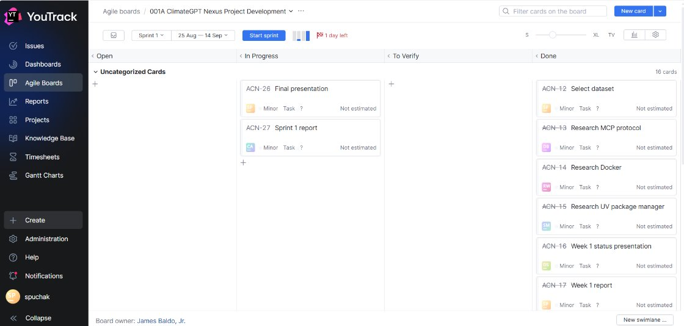
YouTrack

